Slide 1
BT201
Biochemical Process Calculations
28/07/2022

Slide 2
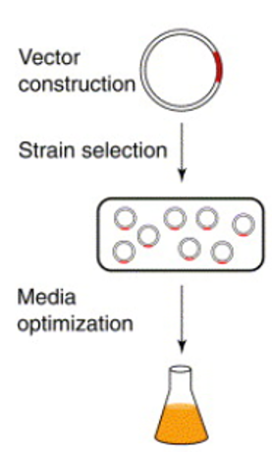
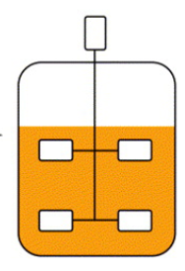
Biochemical process
Raw materials
(reactant: C, N,P)
Enzyme
wild type or
engineered cell
Pure product
Product recovery/
Purification/downstream
Microorganism
Production
(in bioreactor
10 kL to 50 kL)
(filtration,
extraction,
distillation,
adsorption
and drying
/freeze drying)
(Upstream)
(Fermentation)
(Downstream)

Slide 3
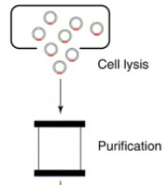
Downstream process
The separation and purification of desired fermentation product is downstream processing or bioseparation
For extracellular product
Removal of insoluble (biomass)
Product Isolation
Product Purification
For intracellular product
separation/concentration of insoluble (biomass)
Cell disruption
Product isolation
Product Purification

Slide 4
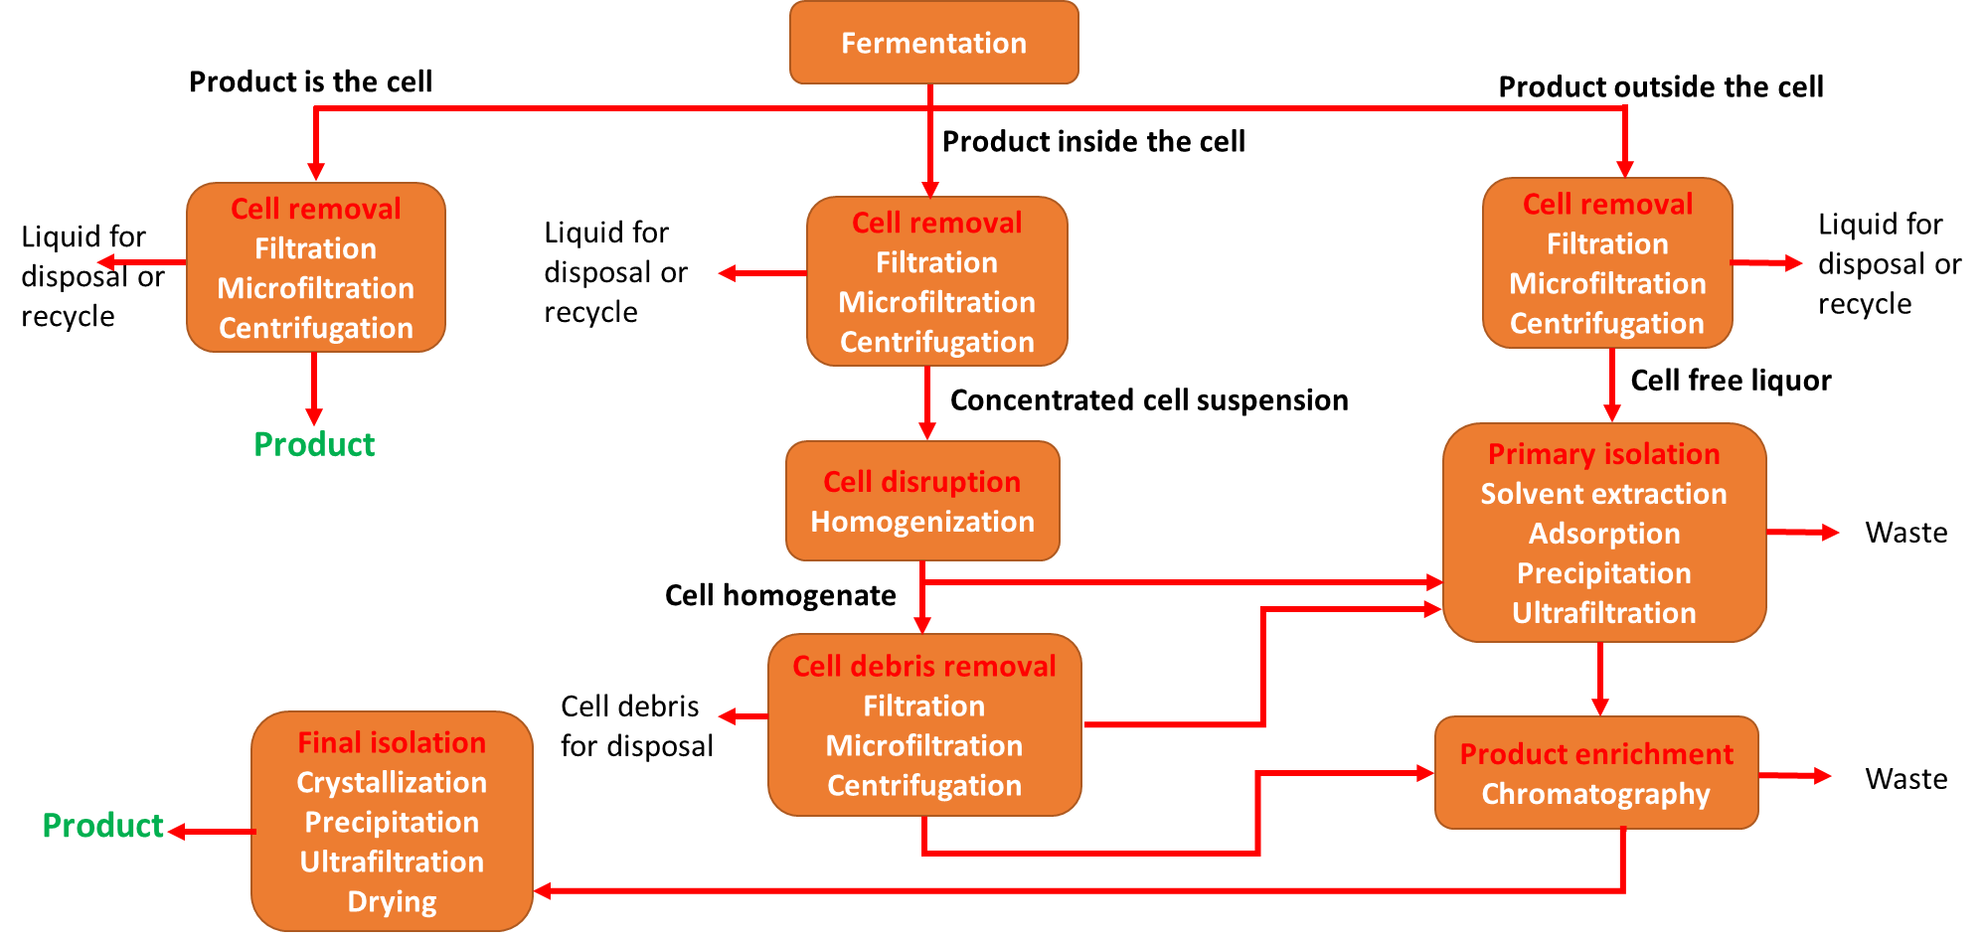
Product recovery (Downstream process)

Slide 5
Typical product quality during downstream
Steps | Typical unit operation | Product concentration (g/l) | Product purity (%)
Harvest broth |  | 0.1-5 | 0.1-1
Cell removal | Filtration | 1-5 | 0.2-2
Primary isolation | Extraction | 5-50 | 1-10
Product enrichment | Chromatography | 50-200 | 50-80
Final isolation | crystallization | 50-200 | 90-100

Slide 6
Topics
Dimensions and Units: Dimensions and System of Units, Fundamental and derived units, Dimensional consistency, Dimensional equations, Different ways of expression of units of quantities and physical constant, Unit conversion and significance.
Basic Biochemical Calculations: Mole, molecular weight, mole/mass fractions calculations, composition of gas, liquid and solid mixtures, Ideal gas law and other equations of state equations & applications, Dalton's law, Raoult's law, Henry's law, Solutions and properties.
Material Balances without biochemical reaction: Process flow sheet, degree of freedom, Material balance with and without recycle; Bypass and purge streams, Material balances around equipments related to unit operations like filtration, extraction, distillation column, adsorption and drying/freeze drying. Material balance of unsteady state operations
Material balance involving biochemical reaction: Concept of limiting and excess reactants, percentage conversion, yield and selectivity. Single and multiple reaction Lumped and Distributed processes, Material balance involving reactions with reference to penicillin, lactic acid, and ethanol and biopharmaceuticals production.
Energy Balance: Law of thermodynamics, heat capacity of gas, liquid, solid and mixtures, sensible heat change in gas and liquid, enthalpy change in phase transformation, enthalpy change accompanied by biochemical reaction, Standard heat of reaction, heat of mixing and dissolution of solids, Hess's law, Humidity chart, Energy balance involving biochemical reaction.
Case Studies: Flow chart based material and energy balance calculations.

Slide 7
Evaluation
Exam | Contribution | Date
Quiz-1 | 10% | August
Midsem | 30% | September
Quiz-2 | 10% | October
Assignment-1 | 10% | October-November
Endsem | 40% | November

Slide 8
Books
Text Books
David M. Himmelblau, James B. Riggs, PHI Learning Pvt. Ltd, 7th edition, 2006. Basic Principles & Calculations in Chemical Engineering",
Richard M. Felder, Ronald W. Rousseau, Wiley, 3rd edition, 2004. Elementary Principles of Chemical Processes.
Pauline M. Doran. Bioprocess Engineering Principles. 2nd ed. Elsevier Science & Technology Books. 1995.
References
O.A.Hougen, K.M.Watson, R.A.Ragatz, CBS Publishers New Delhi, 2nd edition, 2004.Chemical Process Principles Part-I: Material and Energy Balances.

Slide 9
Units and dimensions
Dimensions are the general expression of a characteristic of measurement such as length, time, mass, temperature, and so on;
units are the means of explicitly expressing the dimensions, such as feet or centimeters for length, or hours or seconds for time. Primarily two types of units are used in this text:
System of units
Systeme Internationale d’Unites or SI
Accepted by engineering community
CGS system
almost identical to SI, the principal difference being that grams (g) and centimeters (cm) are used instead of kilograms and meters
American Engineering system or AE system
This system has difficulty. Occurrence of conversion factors (such as 1 ft=12 inch, 1 yard=3 feet, 1 mile=1760 yard), which, unlike those in the metric systems, are not multiples of 10.
It has also problem with force unit (Ib_{f})

Slide 10
Classification
1. Fundamental (or basic) dimensions/units are those that can be measured independently and are sufficient to describe most physical quantities such as mass (M), length (L), time (t), temperature (T), mole (N), electrical current (I), and light intensity etc.
2. Multiple units, which are defined as multiples or fractions of base units such as minutes,
hours, and milliseconds, all of which are defined in terms of the base unit of a second.
Multiple units are defined for convenience rather than necessity: it is simply more convenient
to refer to 3 yr than to 94,608,000 s.
3. Derived dimensions/units are those that can be developed in terms of the fundamental
dimensions/units
Derived units obtained in one of two ways:
By multiplying and dividing base or multiple units (cm² , ft/min, kg.m/s , etc.).

Slide 11
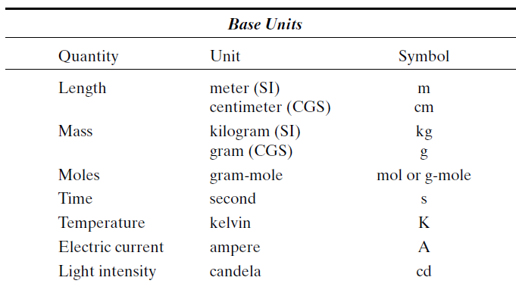
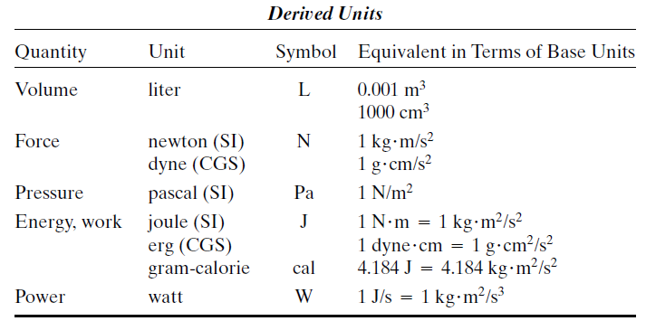
SI and CGS Units
(L)
(M)
(N)
(T)
(θ)
(Dimension)
(I)
(L³)
(J)
(MLT⁻²)
(ML⁻¹T⁻²)
(ML²T⁻²)
(ML²T⁻³)

Slide 12
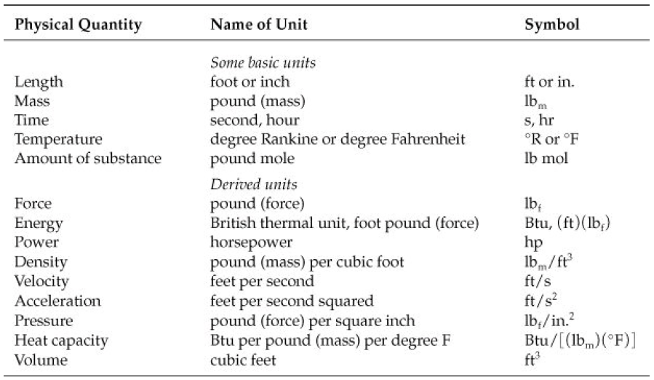

Slide 13

Conversion of system of units
Procedure for converting one set of units to another is simply to multiply any number and its associated units by ratios termed conversion factors
Note that because conversion factors are composed of equivalents between units, multiplying a quantity by one or more conversion factors does not actually change the basic quantity, only its numerical value and its units
Raising a quantity (in particular, a conversion factor) to a power raises its units to the same power.
In this example note that not only are the numbers raised to a power, but the units also are raised to the same power
Change 400 in³/day to cm³/min

Slide 14
Dimensional Homogeneity
A basic principle exists that equations must be dimensionally consistent.
What the principle means is that each term in an equation must have the same net dimensions
Every valid equation must be dimensionally homogeneous: that is, all additive terms on both sides of the equation must have the same dimensions.
u=u₀+gt
Dimension of LHS= LT⁻¹
Dimension of RHS= LT⁻¹+ LT⁻² x T = LT⁻¹

Slide 15

Cont.
The concept of dimensional consistency can be illustrated by an equation that represents the
pressure/volume/temperature behavior of a gas and is known as van der Waals’ equation
Units of a and b?
Constant a must have the units of [(pressure)(volume)⁻²] because each term inside the first bracket must have units of pressure.
Similarly, b must have the same units as V, or in this particular case the units of cubic
centimeters. If T is in kelvin, what must be the units of R?
All equations must exhibit dimensional consistency.

Slide 16


Nondimensional/dimensionless groups/number
Groups of symbols may be put together, either by theory or based on experiment, that have no net units. Such collections of variables or parameters are called dimensionless or nondimensional groups. One example is the Reynolds number that arises in fluid mechanics:
where D is the pipe diameter (e.g., cm), ν is the fluid velocity (e.g., cm/s), ρ is the fluid density (e.g.,
g/cm3), and μ is the viscosity [usually given in the units of centipoise, which itself has the units of
g/(cm)(s)].

Slide 17

Process parameters and variables
Process variables that characterize the operation of processes and individual process units.
Basic parameters: Mass, mole, volume, specific volume (volume/mass), mass per unit volume of the substance (density).
The specific gravity of a substance is the ratio of the density of the substance to the density of a reference substance at a specific condition, Dimensionless term
The reference most commonly used for solids and liquids is water at 4 º C

Slide 18
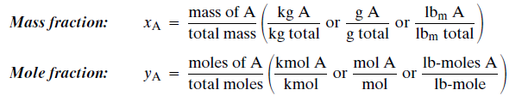
Chemical Composition of mixture
Process streams occasionally contain one substance, but more often they consist of mixtures of liquids or gases, or solutions of one or more solutes in a liquid solvent.
Biochemical/chemical process systems are mixtures of various species.
The physical properties of a mixture depend strongly on the mixture composition.
Different ways to express mixture compositions,
Estimating physical properties of a mixture from the properties of the pure components.
Mass and Mole Fractions

Slide 19
Cont..
For gas: Unless otherwise specified, when a percentage or fraction is given for a gas, it is assumed that it refers to a mole percentage or a mole fraction (y).
For liquid/solid: When a percentage or fraction is given for a liquid or a solid, it is assumed that it refers to a weight percentage or a weight fraction (x).

Slide 20
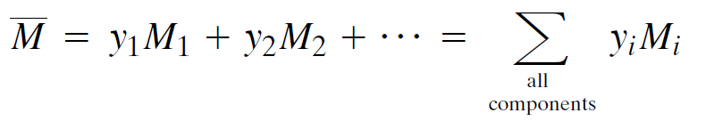

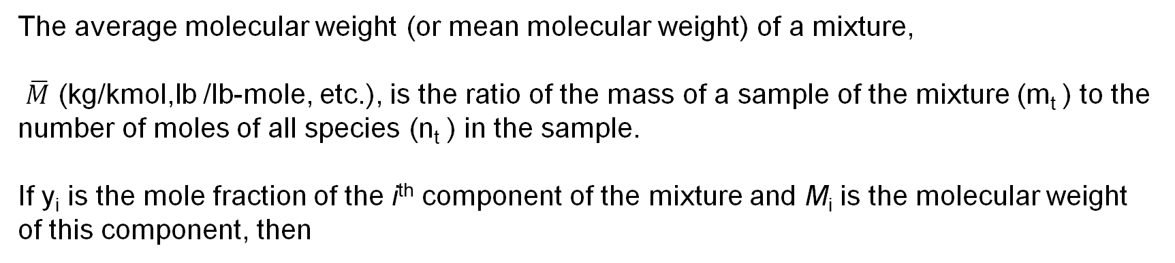
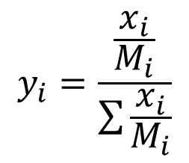
Average molecular weight
The average molecular weight (or mean molecular weight) of a mixture,
$\overline{M}$ (kg/kmol,lb /lb-mole, etc.), is the ratio of the mass of a sample of the mixture (m_{t} ) to the number of moles of all species (n_{t} ) in the sample.
If y_{i} is the mole fraction of the i^{th} component of the mixture and M_{i} is the molecular weight of this component, then
If x_{i} is the mass fraction of the i^{th} component, then
$$y_{i}=\frac{\frac{x_{i}}{M_{i}}}{\sum{\frac{x_{i}}{M_{i}}}}$$

Slide 21

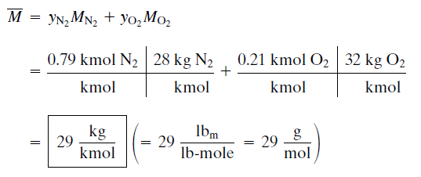
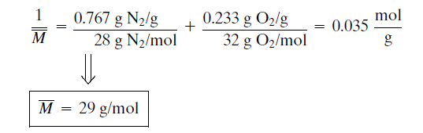
cont..
Average molecular weight of air
(1) from its approximate molar composition of 79% N2 ,and 21% O2 and
(2) from its approximate composition by mass of 76.7% N , 23.3% O2 .
(1)
(2)

